Slide 1
PORTOFOLIO
AINUN NASHIKHA
CASE STUDY PRIME VIDEO
+6287866231254 | ainunnasikhaa@gmail.com| https://www.linkedin.com/in/ainun-nashikha/ | Tangerang

Slide 2
Berikut merupakan link Spreedsheet Dataset Prime Video
https://docs.google.com/spreadsheets/d/105vK9yHsCV8gbrzS2NOuHt2310J6WAMquyNpTsxC-LE/edit?usp=sharing

Slide 3
Analyst Amazon Prime Video
Dalam analisis ini saya melakukan beberapa tahapan, yaitu:
1. Import
2.Clean - Remove duplicate
3.Clean - Handle missing data
4.Enhance
5.Clean - Exclude outer
6.Analyze & Visualization
Percentage type of show
number of title by release year at 2000 aand more
number of title by added year
Top 5 movie have a longest duration?
Top 5 tv show have a most seasion?
Average duration of movie by top 10 director

Slide 4
Berikut merupakan link visualisasi prime video di GDS
https://lookerstudio.google.com/reporting/52692941-bc51-40ee-904d-08b2b4bbef0c

Slide 5
AMAZON PRIME VIDEO
I employed Google Data Studio as the visualization tool for the analysis.
The purpose of my analysis was to gather specific information, which includes:
percentage type of show
TOP 10 Categories on Prime Video
Available Movie & TV Show by Country
Number of title by release year at 2016 and more
Number of show by release year of show
Number of by rating
5 Movie have longest duration

Slide 6
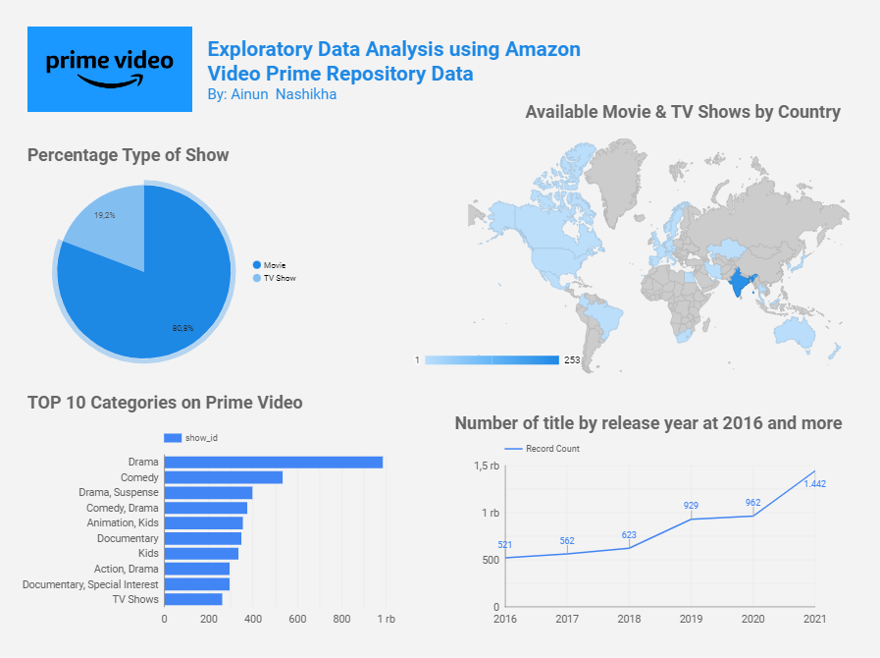
Visualisasi Prime Video

Slide 7
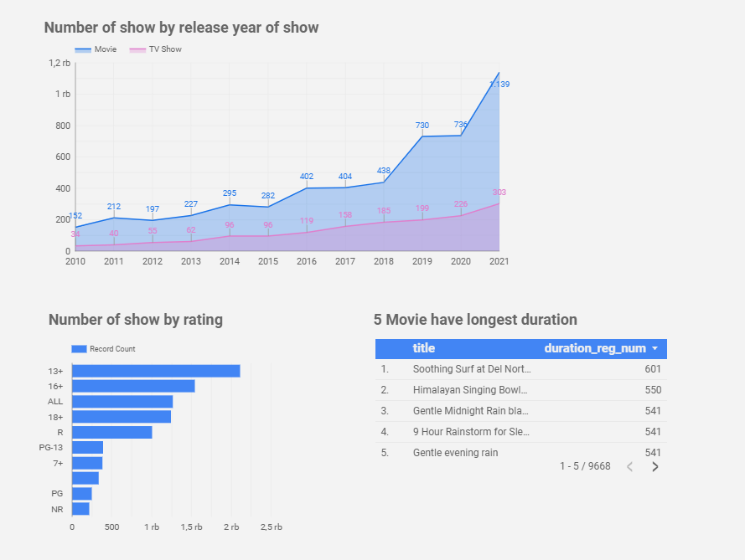
Visualisasi Prime Video

Slide 8
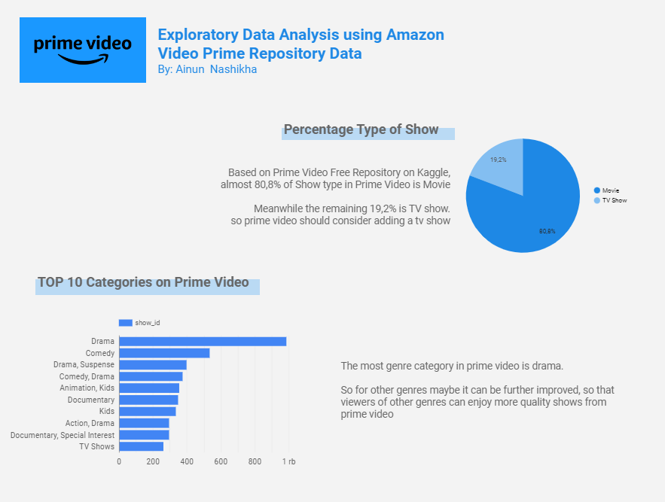
Visualisasi Prime Video

Slide 9
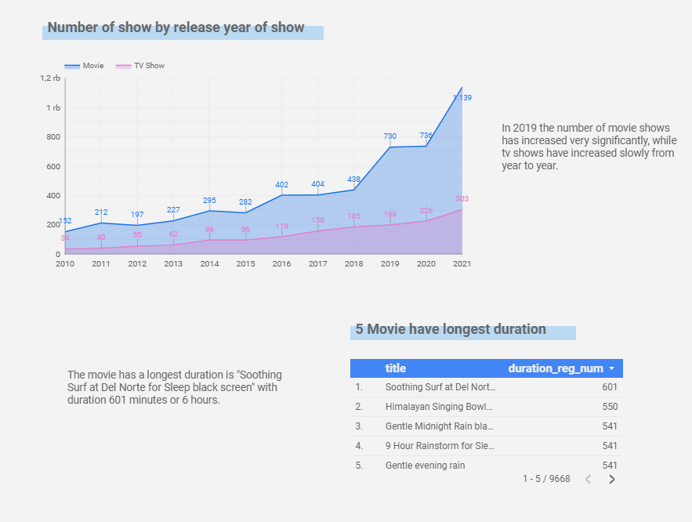
Visualisasi Prime Video

